Slide 1
Clustering – Day 2
Notes:
Highlights: Introduce yourself and the session.
Key Takeaways: NA

Slide 2
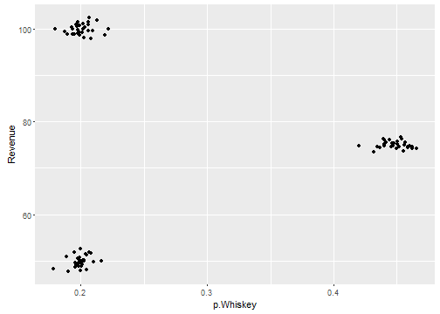
Clustering Kmeans: Good Value of K?
Store_id | P.Whisky | Revenue
1 | 0.40 | 80
2 | 0.20 | 60
3 | 0.35 | 40
4 | 0.22 | 90
5 | 0.45 | 75
How many clusters?
3, K=3
Notes:
Duration: 10 minutes
Highlights:
Introduce the definition.
Identify the unique attributes.
Provide examples to elaborate the concept and non-examples to show the difference.
Use whiteboard if required.
Key Takeaways:
In what ways, learners can use the concept in real-life situations to provide solutions or solve problems.

Slide 3
Clustering Kmeans: Good Value of K?
Income | Credit Limit | # Withdrawls | Card Usage | FICO | Age
… | … | … | … | … | …
… | … | … | … | … | …
… | … | … | … | … | …
How many clusters? 3,4,5,6,..16?
Sometimes, there is context. For example, the marketing team of a bank might want to understand only three segments.
How would we know?
Notes:
Duration: 10 minutes
Highlights:
Introduce the definition.
Identify the unique attributes.
Provide examples to elaborate the concept and non-examples to show the difference.
Use whiteboard if required.
Key Takeaways:
In what ways, learners can use the concept in real-life situations to provide solutions or solve problems.

Slide 4
Clustering Kmeans: Good Value of K?
Income | Credit Limit | # Withdrawls | Card Usage | FICO | Age
… | … | … | … | … | …
… | … | … | … | … | …
… | … | … | … | … | …
How many clusters? 3,4,5,6,..16?
Sometimes, there may be no context available, then how do we figure out a good value of K?
How would we know?
Notes:
Duration: 10 minutes
Highlights:
Introduce the definition.
Identify the unique attributes.
Provide examples to elaborate the concept and non-examples to show the difference.
Use whiteboard if required.
Key Takeaways:
In what ways, learners can use the concept in real-life situations to provide solutions or solve problems.

Slide 5
Clustering Kmeans: Good Value of K?
Income | Credit Limit | # Withdrawls | Card Usage | FICO | Age
… | … | … | … | … | …
… | … | … | … | … | …
… | … | … | … | … | …
How many clusters? 3,4,5,6,..16?
Sometimes, there may be no context available, then how do we figure out a good value of K?
How would we know?
Notes:
Duration: 10 minutes
Highlights:
Introduce the definition.
Identify the unique attributes.
Provide examples to elaborate the concept and non-examples to show the difference.
Use whiteboard if required.
Key Takeaways:
In what ways, learners can use the concept in real-life situations to provide solutions or solve problems.

Slide 6
Clustering Kmeans: Good Value of K?
If we create 3 clusters:
Clusters are compact
Clusters are far apart
So, a good choice of K will lead to:
Compact Clusters
Well separated clusters
Notes:
Duration: 10 minutes
Highlights:
Introduce the definition.
Identify the unique attributes.
Provide examples to elaborate the concept and non-examples to show the difference.
Use whiteboard if required.
Key Takeaways:
In what ways, learners can use the concept in real-life situations to provide solutions or solve problems.

Slide 7
Clustering Kmeans: Good Value of K?
#Clusters | Compactness
1 | M1
2 | M2
3 | M3
4 | M4
.. | ..
Choose K=3
Notes:
Duration: 10 minutes
Highlights:
Introduce the definition.
Identify the unique attributes.
Provide examples to elaborate the concept and non-examples to show the difference.
Use whiteboard if required.
Key Takeaways:
In what ways, learners can use the concept in real-life situations to provide solutions or solve problems.

Slide 8
Clustering Kmeans: Good Value of K?
Can we measure the compactness of clusters?
Notes:
Duration: 10 minutes
Highlights:
Introduce the definition.
Identify the unique attributes.
Provide examples to elaborate the concept and non-examples to show the difference.
Use whiteboard if required.
Key Takeaways:
In what ways, learners can use the concept in real-life situations to provide solutions or solve problems.

Slide 9
Clustering Kmeans: Good Value of K?
Can we measure the compactness of clusters?
Rev | P.Whisky
.. | ..
.. | ..
.. | ..
.. | ..
.. | ..
.. | ..
.. | ..
Notes:
Duration: 10 minutes
Highlights:
Introduce the definition.
Identify the unique attributes.
Provide examples to elaborate the concept and non-examples to show the difference.
Use whiteboard if required.
Key Takeaways:
In what ways, learners can use the concept in real-life situations to provide solutions or solve problems.

Slide 10
Clustering Kmeans: Good Value of K?
Can we measure the compactness of clusters?
Rev | P.Whisky
.. | ..
.. | ..
.. | ..
.. | ..
.. | ..
.. | ..
.. | ..
Notes:
Duration: 10 minutes
Highlights:
Introduce the definition.
Identify the unique attributes.
Provide examples to elaborate the concept and non-examples to show the difference.
Use whiteboard if required.
Key Takeaways:
In what ways, learners can use the concept in real-life situations to provide solutions or solve problems.

Slide 11
Clustering Kmeans: Good Value of K?
Can we measure the compactness of clusters?
Rev | P.Whisky
.. | ..
.. | ..
.. | ..
.. | ..
.. | ..
.. | ..
.. | ..
Notes:
Duration: 10 minutes
Highlights:
Introduce the definition.
Identify the unique attributes.
Provide examples to elaborate the concept and non-examples to show the difference.
Use whiteboard if required.
Key Takeaways:
In what ways, learners can use the concept in real-life situations to provide solutions or solve problems.

Slide 12
Clustering Kmeans: Good Value of K?
Can we measure the compactness of clusters?
Rev | P.Whisky
.. | ..
78 | 0.42
75 | 0.45
76 | 0.42
.. | ..
.. | ..
.. | ..
Notes:
Duration: 10 minutes
Highlights:
Introduce the definition.
Identify the unique attributes.
Provide examples to elaborate the concept and non-examples to show the difference.
Use whiteboard if required.
Key Takeaways:
In what ways, learners can use the concept in real-life situations to provide solutions or solve problems.

Slide 13

Clustering Kmeans: Good Value of K?
Can we measure the compactness of clusters?
Rev | P.Whisky
.. | ..
78 | 0.42
75 | 0.45
76 | 0.42
.. | ..
.. | ..
.. | ..
$$WSS_{1}=∑{\left(x_{i}−μ_{i}\right)}^{2}$$
Notes:
Duration: 10 minutes
Highlights:
Introduce the definition.
Identify the unique attributes.
Provide examples to elaborate the concept and non-examples to show the difference.
Use whiteboard if required.
Key Takeaways:
In what ways, learners can use the concept in real-life situations to provide solutions or solve problems.

Slide 14
Clustering Kmeans: Good Value of K?
Can we measure the compactness of clusters?
Rev | P.Whisky
.. | ..
78 | 0.42
75 | 0.45
76 | 0.42
.. | ..
.. | ..
.. | ..
$$WSS_{1}=∑{\left(x_{i}−μ_{i}\right)}^{2}$$
$$WSS_{1}={\left(78−75\right)}^{2}+{\left(0.42−0.45\right)}^{2}+{\left(76−75\right)}^{2}+{\left(0.42−0.45\right)}^{2}$$
Notes:
Duration: 10 minutes
Highlights:
Introduce the definition.
Identify the unique attributes.
Provide examples to elaborate the concept and non-examples to show the difference.
Use whiteboard if required.
Key Takeaways:
In what ways, learners can use the concept in real-life situations to provide solutions or solve problems.

Slide 15

Clustering Kmeans: Good Value of K?
Can we measure the compactness of clusters?
$$WSS_{2}=∑{\left(x_{i}−μ_{i}\right)}^{2}$$
Notes:
Duration: 10 minutes
Highlights:
Introduce the definition.
Identify the unique attributes.
Provide examples to elaborate the concept and non-examples to show the difference.
Use whiteboard if required.
Key Takeaways:
In what ways, learners can use the concept in real-life situations to provide solutions or solve problems.

Slide 16

Clustering Kmeans: Good Value of K?
Can we measure the compactness of clusters?
$$WSS_{3}=∑{\left(x_{i}−μ_{i}\right)}^{2}$$
Notes:
Duration: 10 minutes
Highlights:
Introduce the definition.
Identify the unique attributes.
Provide examples to elaborate the concept and non-examples to show the difference.
Use whiteboard if required.
Key Takeaways:
In what ways, learners can use the concept in real-life situations to provide solutions or solve problems.

Slide 17
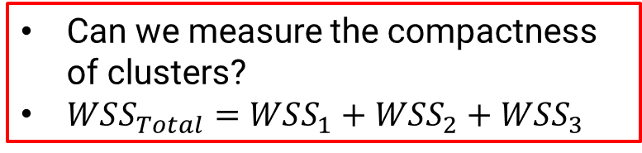
Clustering Kmeans: Good Value of K?
Can we measure the compactness of clusters?
$WSS_{Total}=WSS_{1}+WSS_{2}+WSS_{3}$
Notes:
Duration: 10 minutes
Highlights:
Introduce the definition.
Identify the unique attributes.
Provide examples to elaborate the concept and non-examples to show the difference.
Use whiteboard if required.
Key Takeaways:
In what ways, learners can use the concept in real-life situations to provide solutions or solve problems.

Slide 18
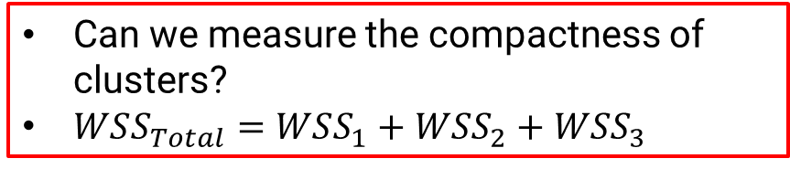

Clustering Kmeans: Good Value of K?
Can we measure the compactness of clusters?
$WSS_{Total}=WSS_{1}+WSS_{2}+WSS_{3}$
or
$WSS_{Average}=\frac{1}{3}(WSS_{1}+WSS_{2}+WSS_{3})$
Notes:
Duration: 10 minutes
Highlights:
Introduce the definition.
Identify the unique attributes.
Provide examples to elaborate the concept and non-examples to show the difference.
Use whiteboard if required.
Key Takeaways:
In what ways, learners can use the concept in real-life situations to provide solutions or solve problems.

Slide 19

Clustering Kmeans: Good Value of K?
Can we measure the compactness of clusters?
$WSS_{Total}=WSS_{1}+WSS_{2}+WSS_{3}$
or
$WSS_{Average}=\frac{1}{3}(WSS_{1}+WSS_{2}+WSS_{3})$
#Clusters | WSS
1 | M1
2 | M2
3 | M3
4 | M4
.. | ..
Notes:
Duration: 10 minutes
Highlights:
Introduce the definition.
Identify the unique attributes.
Provide examples to elaborate the concept and non-examples to show the difference.
Use whiteboard if required.
Key Takeaways:
In what ways, learners can use the concept in real-life situations to provide solutions or solve problems.

Slide 20
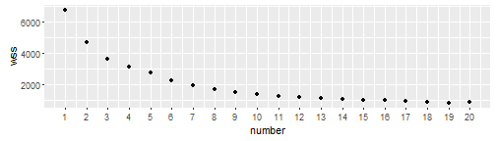
Clustering Kmeans: Good Value of K?
Notes:
Duration: 10 minutes
Highlights:
Introduce the definition.
Identify the unique attributes.
Provide examples to elaborate the concept and non-examples to show the difference.
Use whiteboard if required.
Key Takeaways:
In what ways, learners can use the concept in real-life situations to provide solutions or solve problems.

Slide 21
Clustering Kmeans: Good Value of K?
Notes:
Duration: 10 minutes
Highlights:
Introduce the definition.
Identify the unique attributes.
Provide examples to elaborate the concept and non-examples to show the difference.
Use whiteboard if required.
Key Takeaways:
In what ways, learners can use the concept in real-life situations to provide solutions or solve problems.

Slide 22
Clustering Kmeans: Good Value of K?
Anything between 8 to 12 clusters is a good number.
Notes:
Duration: 10 minutes
Highlights:
Introduce the definition.
Identify the unique attributes.
Provide examples to elaborate the concept and non-examples to show the difference.
Use whiteboard if required.
Key Takeaways:
In what ways, learners can use the concept in real-life situations to provide solutions or solve problems.

Slide 23
Clustering Class Exercise
Age | Weight | Cluster
30 | 67 | C1
35 | 70 | C1
25 | 64 | C2
23 | 62 | C2
Center | X (Age) | Y (Weight)
C1 | 32 | 68
C2 | 24 | 63
Find out $WSS_{average}$for the data given above.
Notes:
Duration: 10 minutes
Highlights:
Introduce the definition.
Identify the unique attributes.
Provide examples to elaborate the concept and non-examples to show the difference.
Use whiteboard if required.
Key Takeaways:
In what ways, learners can use the concept in real-life situations to provide solutions or solve problems.

Slide 24
Clustering Class Exercise
Age | Weight | Cluster
30 | 67 | C1
35 | 70 | C1
25 | 64 | C2
23 | 62 | C2
Center | X (Age) | Y (Weight)
C1 | 32 | 68
C2 | 24 | 63
Find out $WSS_{average}$for the data given above.
See Numerical Example Clustering.xlsx in sheet Class Exercise WSS
Notes:
Duration: 10 minutes
Highlights:
Introduce the definition.
Identify the unique attributes.
Provide examples to elaborate the concept and non-examples to show the difference.
Use whiteboard if required.
Key Takeaways:
In what ways, learners can use the concept in real-life situations to provide solutions or solve problems.

Slide 25
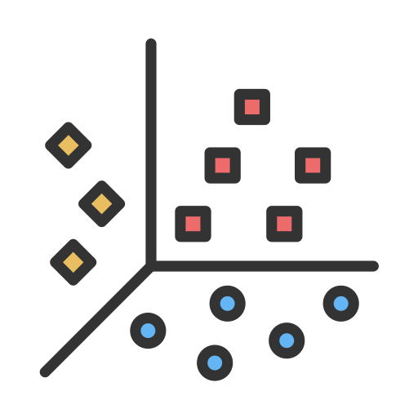
Clustering: Elbow Curve Demo
Links: https://github.com/Gunnvant/Self-Paced-Content/tree/main/python/clustering/Class%20Demos
Notes:
Duration: 10 minutes
Highlights:
Introduce the definition.
Identify the unique attributes.
Provide examples to elaborate the concept and non-examples to show the difference.
Use whiteboard if required.
Key Takeaways:
In what ways, learners can use the concept in real-life situations to provide solutions or solve problems.

Slide 26
Clustering Kmeans: Good Value of K?
Anything between 8 to 12 clusters is a good number.
Now what?
Notes:
Duration: 10 minutes
Highlights:
Introduce the definition.
Identify the unique attributes.
Provide examples to elaborate the concept and non-examples to show the difference.
Use whiteboard if required.
Key Takeaways:
In what ways, learners can use the concept in real-life situations to provide solutions or solve problems.

Slide 27
Clustering: Profiling Clusters
Once you finalize the number of clusters, you will then need to describe these clusters.
This is done via a process known as cluster profiling.
Notes:
Duration: 10 minutes
Highlights:
Introduce the definition.
Identify the unique attributes.
Provide examples to elaborate the concept and non-examples to show the difference.
Use whiteboard if required.
Key Takeaways:
In what ways, learners can use the concept in real-life situations to provide solutions or solve problems.

Slide 28
Clustering Kmeans: Good Value of K? Cluster Profiles
Revenue | P.Whisky | Cluster
.. | .. | 1
.. | .. | 1
.. | .. | 2
.. | .. | 2
.. | .. | 3
.. | .. | 3
.. | .. | 1
Mean Revenue= 120, std = 10
Mean Revenue Cluster 1 = 200
Mean Revenue Cluster 2 = 125 Mean Revenue Cluster 3 = 75
Mean P.Whisky= 0.20, std= 0.10
Mean P.Whisky Cluster 1 = 0.40
Mean P.Whisky Cluster 2 = 0.21 Mean P.Whisky Cluster 3 = 0.05
Notes:
Duration: 10 minutes
Highlights:
Introduce the definition.
Identify the unique attributes.
Provide examples to elaborate the concept and non-examples to show the difference.
Use whiteboard if required.
Key Takeaways:
In what ways, learners can use the concept in real-life situations to provide solutions or solve problems.

Slide 29
Clustering Kmeans: Good Value of K? Cluster Profiles
Revenue | P.Whisky | Cluster
.. | .. | 1
.. | .. | 1
.. | .. | 2
.. | .. | 2
.. | .. | 3
.. | .. | 3
.. | .. | 1
Mean Revenue= 120, std = 10
Mean Revenue Cluster 1 = 200
Mean Revenue Cluster 2 = 125 Mean Revenue Cluster 3 = 75
Mean P.Whisky= 0.20, std= 0.10
Mean P.Whisky Cluster 1 = 0.40
Mean P.Whisky Cluster 2 = 0.21 Mean P.Whisky Cluster 3 = 0.05
Revenue in cluster 1 is more than average, so cluster 1 is a cluster with high revenue.
Notes:
Duration: 10 minutes
Highlights:
Introduce the definition.
Identify the unique attributes.
Provide examples to elaborate the concept and non-examples to show the difference.
Use whiteboard if required.
Key Takeaways:
In what ways, learners can use the concept in real-life situations to provide solutions or solve problems.

Slide 30
Clustering Kmeans: Good Value of K? Cluster Profiles
Revenue | P.Whisky | Cluster
.. | .. | 1
.. | .. | 1
.. | .. | 2
.. | .. | 2
.. | .. | 3
.. | .. | 3
.. | .. | 1
Mean Revenue= 120, std = 10
Mean Revenue Cluster 1 = 200
Mean Revenue Cluster 2 = 125 Mean Revenue Cluster 3 = 75
Mean P.Whisky= 0.20, std= 0.10
Mean P.Whisky Cluster 1 = 0.40
Mean P.Whisky Cluster 2 = 0.21 Mean P.Whisky Cluster 3 = 0.05
Revenue in cluster 3 is less than average, so cluster 1 is a cluster with low revenue.
Notes:
Duration: 10 minutes
Highlights:
Introduce the definition.
Identify the unique attributes.
Provide examples to elaborate the concept and non-examples to show the difference.
Use whiteboard if required.
Key Takeaways:
In what ways, learners can use the concept in real-life situations to provide solutions or solve problems.

Slide 31
Clustering Kmeans: Good Value of K? Cluster Profiles
Revenue | P.Whisky | Cluster
.. | .. | 1
.. | .. | 1
.. | .. | 2
.. | .. | 2
.. | .. | 3
.. | .. | 3
.. | .. | 1
Mean Revenue = 120, std = 10
Mean Revenue Cluster 1 = 200
Mean Revenue Cluster 2 = 125 Mean Revenue Cluster 3 = 75
Mean P.Whisky = 0.20, std = 0.10
Mean P.Whisky Cluster 1 = 0.40
Mean P.Whisky Cluster 2 = 0.21 Mean P.Whisky Cluster 3 = 0.05
Mean Revenue= 120, std = 10
Z Revenue Cluster 1 = 8
Z Revenue Cluster 2 = 0.5 Z Revenue Cluster 3 = -4.5
Mean P.Whisky= 0.20, std= 0.10
Z P.Whisky Cluster 1 = 2
Z P.Whisky Cluster 2 = 1
Z P.Whisky Cluster 3 = -1.5
Notes:
Duration: 10 minutes
Highlights:
Introduce the definition.
Identify the unique attributes.
Provide examples to elaborate the concept and non-examples to show the difference.
Use whiteboard if required.
Key Takeaways:
In what ways, learners can use the concept in real-life situations to provide solutions or solve problems.

Slide 32
Cluster Profiling: Code Demo
Links: https://github.com/Gunnvant/Self-Paced-Content/tree/main/python/clustering/Class%20Demos
Notes:
Duration: 10 minutes
Highlights:
Introduce the definition.
Identify the unique attributes.
Provide examples to elaborate the concept and non-examples to show the difference.
Use whiteboard if required.
Key Takeaways:
In what ways, learners can use the concept in real-life situations to provide solutions or solve problems.

